Slide 1

Las Vegas Restaurant Inspections
Zizhong Liu
Springboard Capstone 3

Slide 2

1. Introduction
Problem Statement
The main goal of this Capstone project is to explore the possibility of building a classification model to predict the outcome of a restaurant’s next inspection based on the provided data of the previous inspection in Las Vegas. The subtasks consist of 1) to analyze the provided information and interpret all the information; 2) to select important features and perform data cleaning and preprocessing; 3) to find the best classifier to create a model and predict the outcomes.
Key Stakeholders
A stakeholder can be defined generally as any individuals, end-users, or organizations who have an interest in the food regulation, in which restaurant inspection is one of the key components. It is important to take into consideration the views and concerns of relevant stakeholders in policymaking. The stakeholders can come from consumers, enterprises of food business, and food regulatory and enforcement agencies

Slide 3
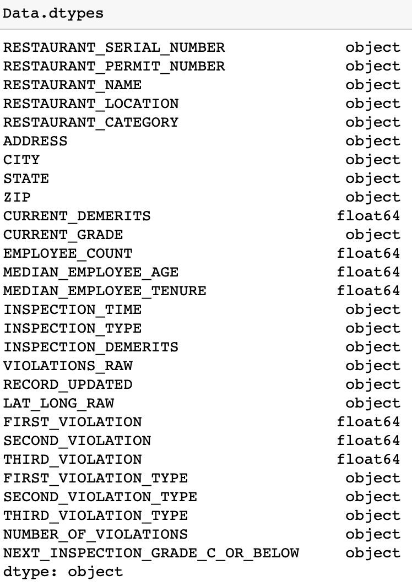
2. Data Analysis
Data Overview
Info (10): RESTAURANT_SERIAL_NUMBER, RESTAURANT_PERMIT_NUMBER, RESTAURANT_NAME, RESTAURANT_LOCATION, ADDRESS, CITY, STATE, ZIP, LAT_LONG_RAW, VIOLATIONS_RAW
Time (2): INSPECTION_TIME, RECORD_UPDATED.
Categorical (6): RESTAURANT_CATEGORY, CURRENT_GRADE, INSPECTION_TYPE, FIRST_VIOLATION_TYPE, SECOND_VIOLATION_TYPE, THIRD_VIOLATION_TYPE.
Target (1): NEXT_INSPECTION_GRADE_C_OR_BELOW (Have noise).
Continuous(9): CURRENT_DEMERITS, EMPLOYEE_COUNT, MEDIAN_EMPLOYEE_AGE, MEDIAN_EMPLOYEE_TENURE, INSPECTION_DEMERITS(NA inside), FIRST_VIOLATION, SECOND_VIOLATION, THIRD_VIOLATION, NUMBER_OF_VIOLATIONS (NA inside).

Slide 4
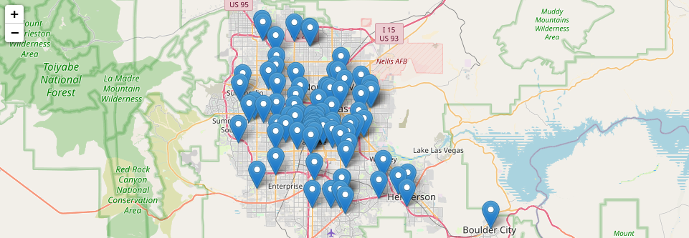
2. Data Analysis
Continuous Features
RESTAURANT_LOCATION

Slide 5
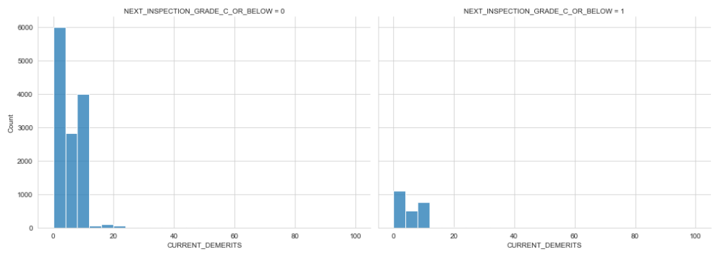
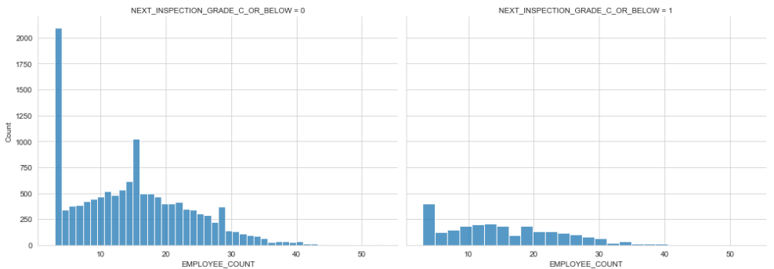
2. Data Analysis
Continuous Features
'CURRENT_DEMERITS'
'EMPLOYEE_COUNT'

Slide 6
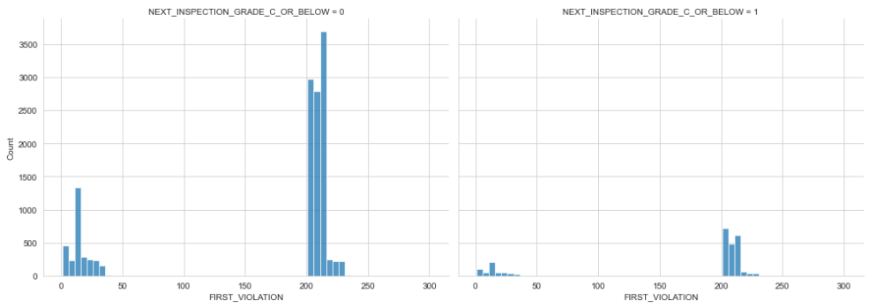
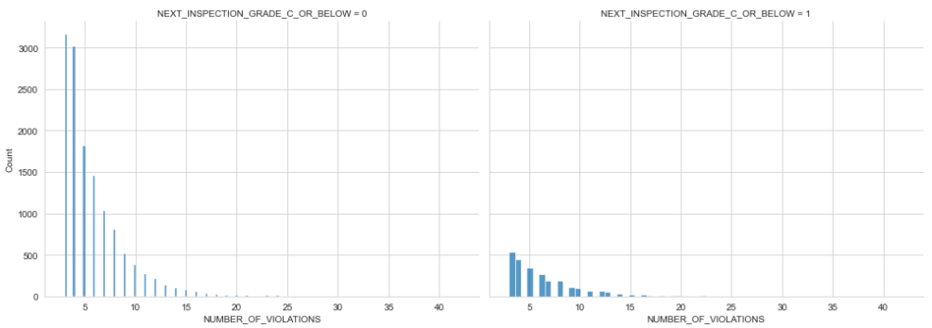
2. Data Analysis
Continuous Features
'FIRST_VIOLATION'
'NUMBER_OF_VIOLATIONS'

Slide 7
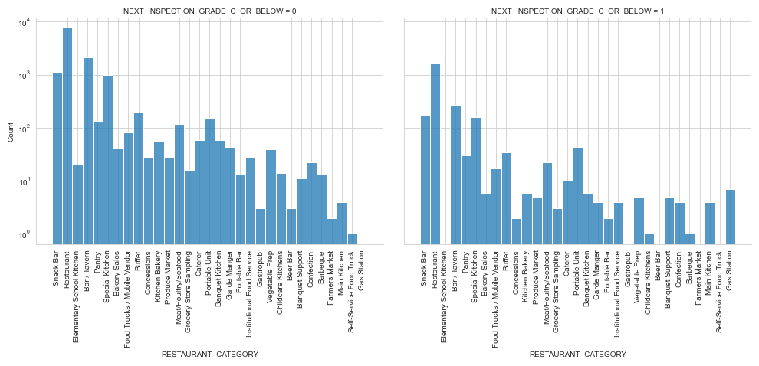
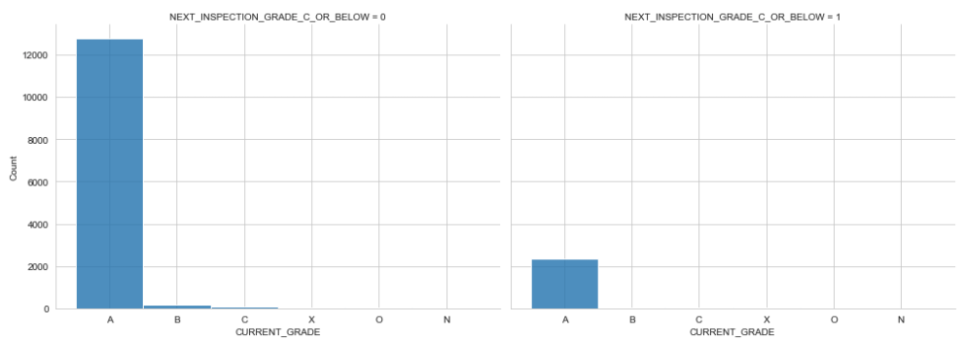
2. Data Analysis
Continuous Features
'RESTAURANT_CATEGORY'
'CURRENT_GRADE'

Slide 8
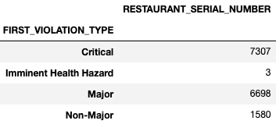
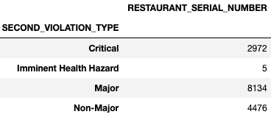
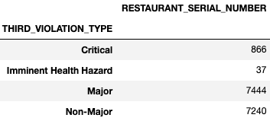
2. Data Analysis
Continuous Features
'FIRST_VIOLATION_TYPE'
'SECOND_VIOLATION_TYPE'
'THIRD_VIOLATION_TYPE'

Slide 9
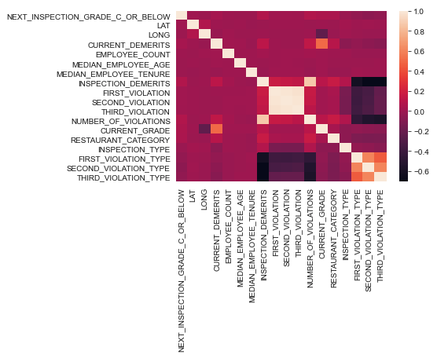
3. Featuring Engineering
Feature Correlations
Investigating the correlation between class and each feature can help us to select the best features. The results show that there are both positive and negative correlations.

Slide 10
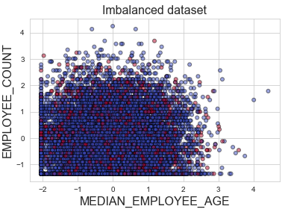
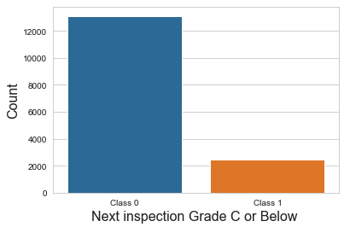
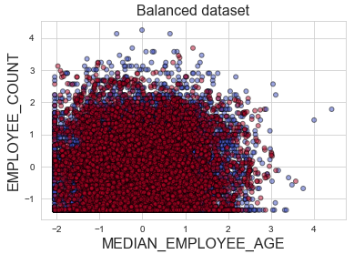
3. Featuring Engineering
Imbalanced data
SMOTE
Before using this data in the model, we need to pay attention to the distribution of the class NEXT_INSPECTION_GRADE_C_OR_BELOW. Counting the number of zeros and ones, we can find that we have imbalanced data.

Slide 11

4. Modeling
Model Selection
Logistic Regression
Decision Tree
Random Forest
KNN or k-Nearest Neighbors
Naive Bayes classifier
Gradient Boosting Classifier
Support Vector Machines
(https://scikit-learn.org/stable/tutorial/machine_learning_map/index.html)

Slide 12
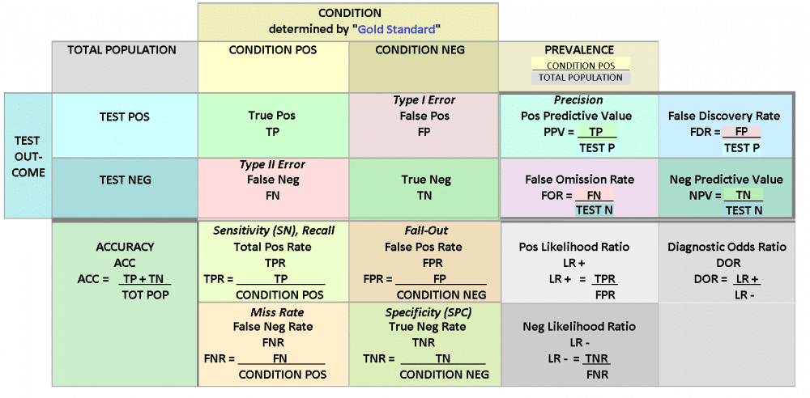
4. Modeling
Model Evaluation
Accuracy: Percentage of correct prediction.
Recall: True Positive / (True Positive + False Negative)
Precision: True Positive / (True Positive + False Positive)
F1-Score: The harmonic mean of precision (PRE) and recall (REC)
Confusion matrix (https://www.unite.ai/what-is-a-confusion-matrix/)

Slide 13
4. Modeling
Results
model | f1 train | f1 val | Accuracy score train | Accuracy score val | best_estimator
Decision Tree Classifier | 0.642973 | 0.843169 | 0.642973 | 0.843169 | DecisionTreeClassifier(max_depth=6, min_samples_leaf=9, min_samples_split=5)
Gradient Boosting Classifier | 0.905686 | 0.827774 | 0.905686 | 0.827774 | GradientBoostingClassifier(learning_rate=0.5)
Gaussian NB | 0.529243 | 0.765876 | 0.529243 | 0.765876 | {'priors': None, 'var_smoothing': 1e-09}
Random Forest Classifier | 0.826639 | 0.761065 | 0.826639 | 0.761065 | RandomForestClassifier(max_depth=9, max_features=4, min_samples_leaf=3, min_samples_split=3)
K Neighbors Classifier | 0.872913 | 0.615779 | 0.872913 | 0.615779 | KNeighborsClassifier(leaf_size=3, p=1)
Logistic Regression | 0.544032 | 0.58948 | 0.544032 | 0.58948 | LogisticRegression(C=0.001, max_iter=1, penalty='none', solver='sag')
SVC | 0.594791 | 0.552919 | 0.594791 | 0.552919 | SVC(C=10, gamma=0.01)

Slide 14
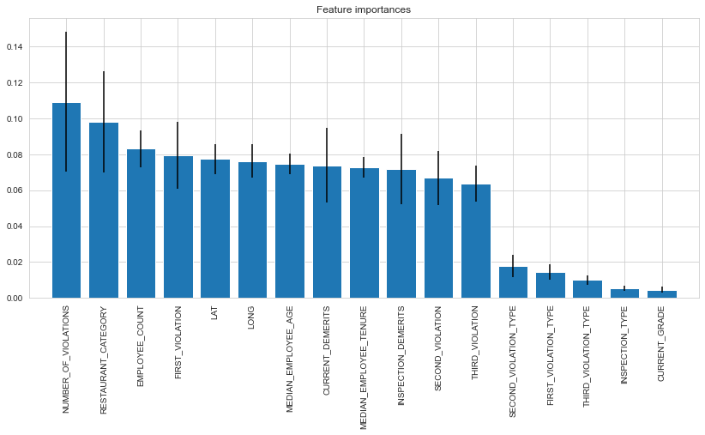
4. Modeling
Feature Importance
Random forest is able to provide feature importance. As shown in the figure below, the 'NUMBER_OF_VIOLATIONS' is the most important feature.

Slide 15
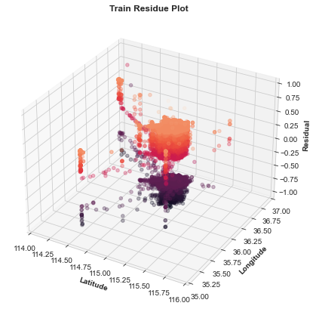
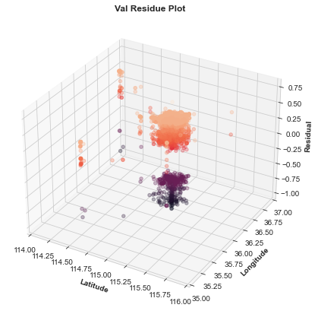
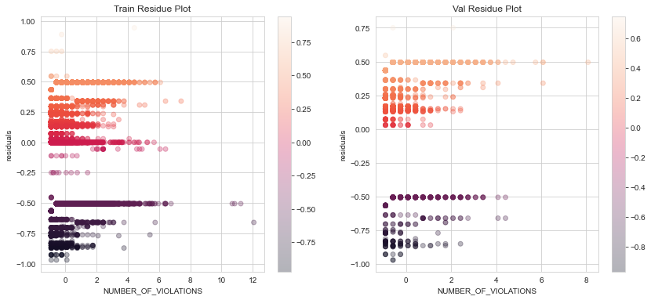
4. Modeling
Residual Plots
The residuals of the probabilities ('NEXT_INSPECTION_GRADE_C_OR_BELOW' = 1) predicted by the best model, Decision Tree, are visualized in terms of the location and 'NUMBER_OF_VIOLATIONS', as shown below. The residual plot shows a random pattern, indicating a good fit for the classification model.

Slide 16
Conclusions
This project investigated the data sets of restaurant inspections in Las Vegas and then built classification models to predict the restaurant’s next inspection below or above C.
Through the project, the model development cycle goes through various important stages, including data collection, data cleaning, data analysis, featuring engineering and model building.
Based on the provided dataset, information, and results, Decision Tree is the optimum model for this dataset with hyperparameters of max_depth = 6, min_samples_leaf = 9, and min_samples_split = 5.
Future works:
For future work to achieve a better prediction, adding more data for class 1 to avoid imbalanced datasets is needed.
In addition, feature importance results show that features like number of violations, restaurant category, employee count, first violation, and locations are important to predict the next inspection. Therefore, implementing further featuring engineering to create new features out of existing ones can improve the accuracy of the model.

